Slide 1
BRITISH AIRWAYS REVIEWS ANALYSIS
Data Collected from their official website

Slide 2
Introduction and background
So, starting with the dataset which was actually scraped from the official website of the British airways using the “Beautiful Soup” function from the “bs4” module. The data is basically a textual data comprised of the customer reviews.
The goal of this analysis is to find out that what are those sentiment words which are getting frequently used in the reviews.
Then depending on there frequency we will decide that whether most of the reviews are good or bad.
For the analysis we have used the “Pandas” library of python and for visualization purpose we have used the “matplotlib” library.

Slide 3
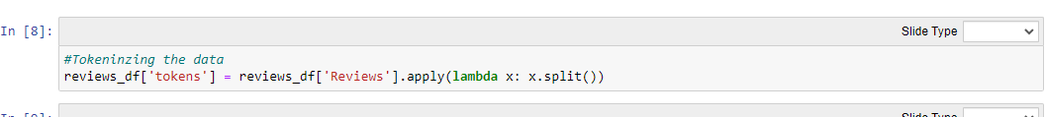
DATA CLEANING AND PRE-PROCESSING
For data cleaning, I have used Microsoft Excel.
We have used the Find and Replace function of the Excel to find all the un-necessary words, stop words and whitespaces and replace them with a single whitespace.
Then we removed the Verified Trip and Non-Verified Trip tag from the data.
I then lowercased all the data to avoid future errors.
After this all the data was tokenized with the use of this code:

Slide 4
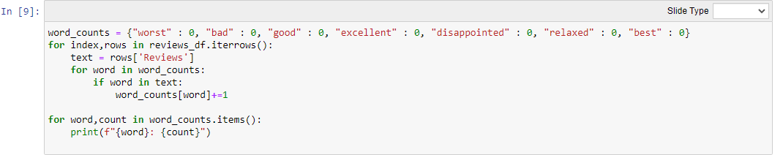
Exploratory data analysis
To fulfil the goal of this analysis, I have created a frequency function which basically counts the frequency of the sentiment words which are specified in a dictionary.
Then a for loop is used to count the occurrence of each word in the data and store the occurrences in a series named word_counts.
The code looks like this:

Slide 5
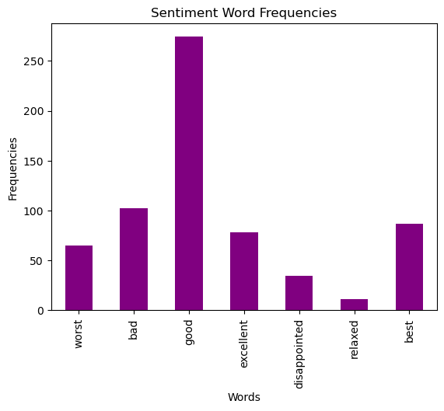
Data visualization
We have plotted a bar plot and a pie chart using the matplotlib library.

Slide 6
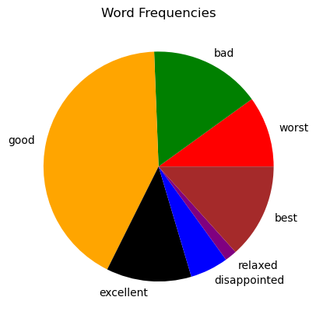

Slide 7
conclusion
So, we can see through the visualizations that most occurred words are those which are considered as Good sentiments.
This can be concluded that most of the reviews are Good Reviews.
But some of them are Bad Reviews also because words like bad and worst have noticeable occurrences.
THANK YOU!

